Slide 1
Devsinc ROLL DICE WEBSITE
USERSTORY

Slide 2
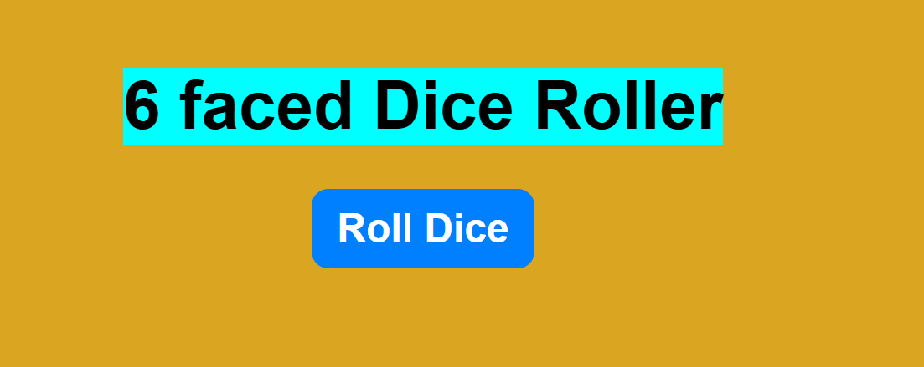
To roll a 6 faced dice, click on the “Roll Dice” button
CLICK THIS BUTTON

Slide 3
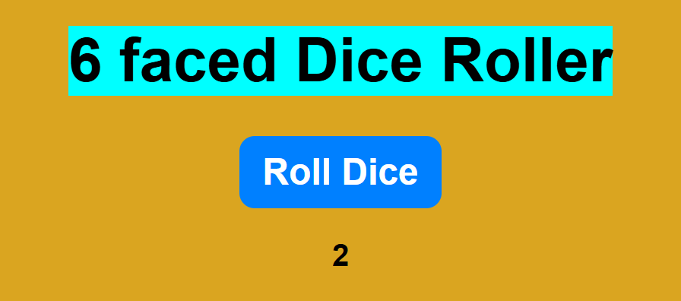
THE NUMBER GENERATES AT THE BOTTOM OF THE BUTTON

Slide 4
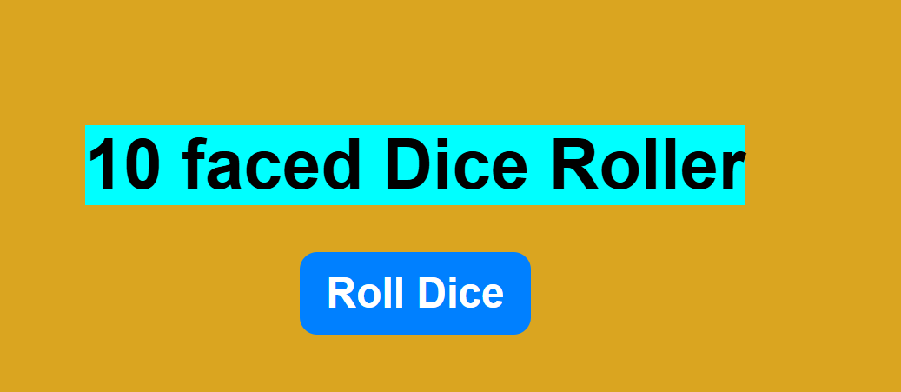
To roll a 6 faced dice, click on the “Roll Dice” button
CLICK THIS BUTTON

Slide 5
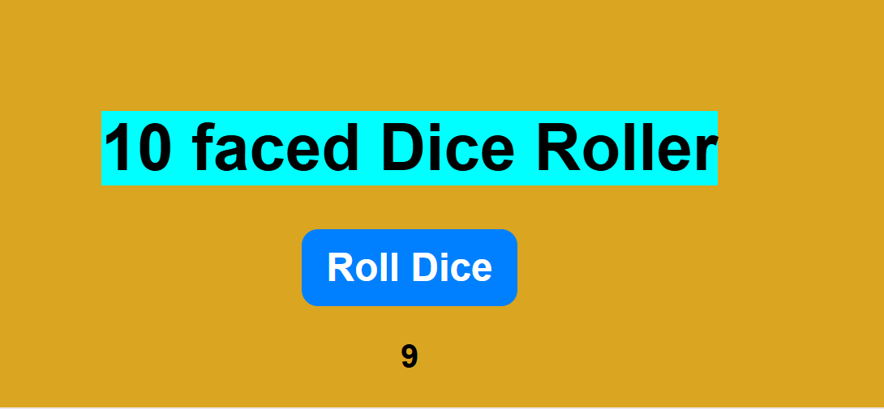
THE NUMBER GENERATES AT THE BOTTOM OF THE BUTTON

